Slide 1
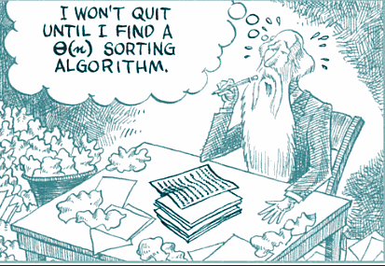
Performance Analysis
Order of Growth

Slide 2
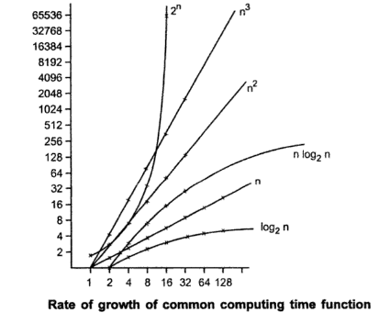
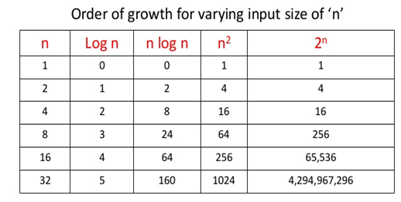
Order of Growth
Measuring the performance of an algorithm in relation with input size n is called order of growth.

Slide 3
How efficiency determines practical usability?
input | logn | n | nlogn | n² | n³ | 2^{n} | n!
10 | 3.3 | 10 | 33 | 100 | 1000 | 1000 | 10⁶
100 | 6.6 | 100 | 66 | 10⁴ | 10⁶ | 10³⁰
1000 | 10 | 1000 | 10⁴ | 10⁶ | 10⁹
10⁴ | 13 | 10⁴ | 10⁵ | 10⁸ | 10¹²
10⁵ | 17 | 10⁵ | 10⁶ | 10¹⁰
10⁶ | 20 | 10⁶ | 10⁷
10⁷ | 23 | 10⁷ | 10⁸
10⁸ | 27 | 10⁸ | 10⁹
10⁹ | 30 | 10⁹ | 10¹⁰
10¹⁰ | 33 | 10¹⁰ | 10¹¹
Acceptability:10 sec i.e 10⁹ Operations

Slide 4
Orders of Magnitude
When comparing T(n) across problems, focus on orders of magnitude and ignore constants
Eg: f(n)=n³ grows faster than g(n)=500n^{2,} How?
Asymptotic complexity
T(n) proportional to
logn Logarithmic
n Linear
n² Quadratic
n³ Cubic
2^{n} Exponential
Polynomial

Slide 5
Growth of Functions- Asymptotic Notations
Asymptotic complexity is a short hand way to represent time complexity.
O –(Big “Oh “)
Ω –(Omega)
Θ – (Theta)

Slide 6
Big Oh Notation
Big-O is the formal method of expressing the upper bound of an algorithm's running time. It's a measure of the longest amount of time it could possibly take for the algorithm to complete.
The function f(n)=O(g(n)) iff there exists a positive constants c and n₀ such that f(n)<=c*g(n) for all n>=n₀
1< logn < √n < n < nlogn < n² < n³ <… <2^{n} < 3^{n} <…< n^{n}

Slide 7
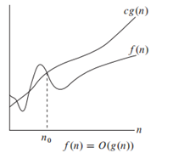
Big-oh
Doesn’t matter
Notes:
∃-There exists ∀-For every

Slide 8
Example-Big O
3n+2 = O(n)
3n+2 = O(n²)
3n+2 ≠ O(1)
10n²+4n+2 = O(n²)
10n²+4n+2 = O(n⁴)
10n²+4n+2 ≠ O(n)
Since we're trying to generalize this for large values of n, and small values (1, 2, 3,…) aren't that important, we can say that f(n) is generally faster than g(n); that is, f(n) is bound by g(n), and will always be less than it.
For f(n)=O(g(n)) to be informative g(n) should be as small a function of n as one can come up with, for which f(n)=Og(n).
1< logn < √n < n < nlogn < n² < n³ <… <2^{n} < 3^{n} <…< n^{n}

Slide 9
Big Ω- Omega
For non-negative functions, f(n) and g(n), if there exists an integer n₀ and a constant c > 0 such that for all integers n > n₀, f(n) ≥ cg(n), then f(n) is omega of g(n).
Denoted as "f(n) = Ω(g(n))".
This is almost the same definition as Big Oh, except that "f(n) ≥ cg(n)", this makes g(n) a lower bound function, instead of an upper bound function. It describes the best that can happen for a given data size.
1< logn < √n < n < nlogn < n² < n³ <… <2^{n} < 3^{n} <…< n^{n}

Slide 10
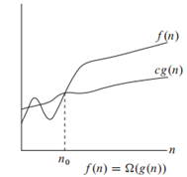
Big- Ω omega
Doesn’t matter

Slide 11
Ω-Notation: Examples
3n+2= Ω(n)
3n+2= Ω(1)
10n²+4n+2= Ω(n²)
10n²+4n+2= Ω(n)
10n²+4n+2= Ω(1)
For f(n)= Ω(g(n)) to be informative g(n) should be as large a function of n as possible, for which f(n)= Ω g(n) is true.
1< logn < √n < n < nlogn < n² < n³ <… <2^{n} < 3^{n} <…< n^{n}

Slide 12
Big Theta
For non-negative functions, f(n) and g(n), f(n) is theta of g(n) if f(n) = O(g(n)) and f(n) = Ω(g(n)).
Denoted as "f(n) = θ(g(n))".
Basically, it says that the function, f(n) is bounded both from the top and bottom by the same function, g(n).
1< logn < √n < n < nlogn < n² < n³ <… <2^{n} < 3^{n} <…< n^{n}

Slide 13
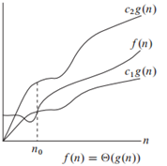
Big-theta

Slide 14
θ Notation-Examples
3n+2 = θ(n)
3n+2>=3n for n>=2
3n+2<=4n for n>=2
c₁=3
c₂=4
n₀=2
1< logn < √n < n < nlogn < n² < n³ < 2^{n} < 3^{n} < n^{n}

Slide 15
Few Examples
f(n)=2n²+3n+4
f(n)=n²logn+n
f(n)=n!
1< logn < √n < n < nlogn < n² < n³ <… <2^{n} < 3^{n} <…< n^{n}

Slide 16
Practical Complexities
When the size of n is large ,
the function 2^{n} grows very rapidly with n
so the utility of algorithms with exponential complexity is limited to small n
Algorithms that have a complexity that is a polynomial of high degree are also of limited utility
From a practical standpoint it is evident that for reasonably large n (say n>100) only algorithms of small complexity such as n,nlogn,n² etc .. are feasible

Slide 17
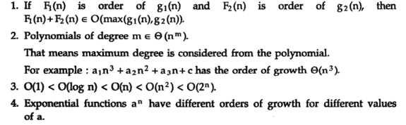
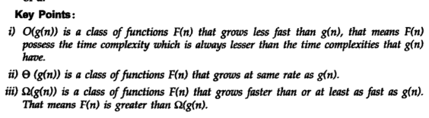
Properties of Order of Growth

Slide 18
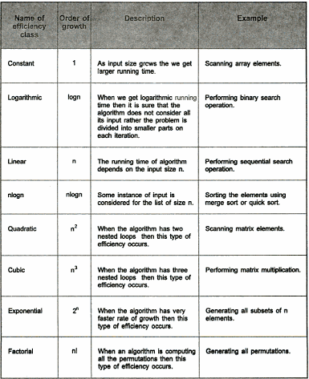

Slide 19


